Slide 1
8. Intractability I
poly-time reductions
packing and covering problems
constraint satisfaction problems
sequencing problems
partitioning problems
numerical problems

Slide 2
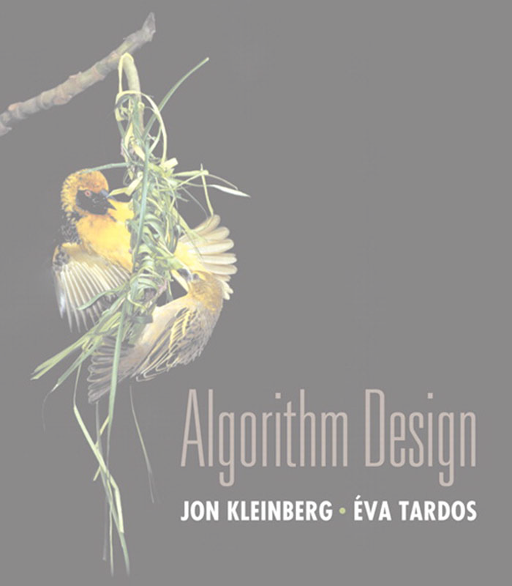

8. Intractability I
poly-time reductions
packing and covering problems
constraint satisfaction problems
sequencing problems
partitioning problems
graph coloring
numerical problems
Section 8.1

Slide 3
Algorithm design patterns and antipatterns
Algorithm design patterns.
・Greedy.
・Divide and conquer.
・Dynamic programming.
・Duality.
・Reductions.
・Local search.
・Randomization.
Algorithm design antipatterns.
・NP-completeness.
・PSPACE-completeness.
・Undecidability.
O(n^{k}) algorithm unlikely.
O(n^{k}) certification algorithm unlikely. No algorithm possible.

Slide 4
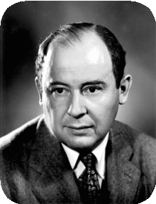

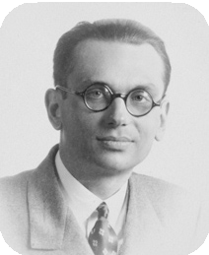




Classify problems according to computational requirements
Q. Which problems will we be able to solve in practice?
A working definition. Those with poly-time algorithms.
von Neumann (1953)
Nash (1955)
Gödel (1956)
Cobham (1964)
Edmonds (1965)
Rabin (1966)
Turing machine, word RAM, uniform circuits, …
Theory. Definition is broad and robust.
constants tend to be small, e.g., 3 n ²
Practice. Poly-time algorithms scale to huge problems.

Slide 5
Classify problems according to computational requirements
Q. Which problems will we be able to solve in practice?
A working definition. Those with poly-time algorithms.
yes | probably no
shortest path | longest path
min cut | max cut
2-satisfiability | 3-satisfiability
planar 4-colorability | planar 3-colorability
bipartite vertex cover | vertex cover
matching | 3d-matching
primality testing | factoring
linear programming | integer linear programming

Slide 6
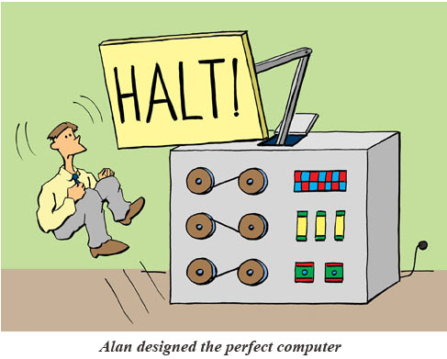
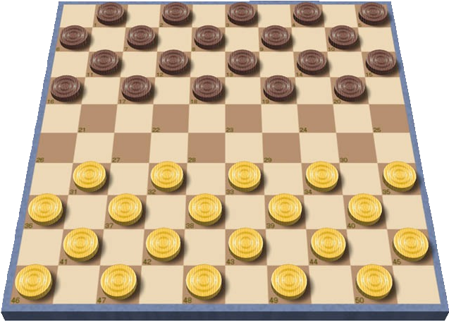
Classify problems
Desiderata. Classify problems according to those that can be solved in polynomial time and those that cannot.
input size = c + log k
Provably requires exponential time.
・Given a constant-size program, does it halt in at most k steps?
・Given a board position in an n-by-n generalization of checkers, can black guarantee a win?
using forced capture rule
Frustrating news. Huge number of fundamental problems have defied classification for decades.

Slide 7
Poly-time reductions
Desiderata′. Suppose we could solve problem Y in polynomial time. What else could we solve in polynomial time?
Reduction. Problem X polynomial-time (Cook) reduces to problem Y if arbitrary instances of problem X can be solved using:
・Polynomial number of standard computational steps, plus
・Polynomial number of calls to oracle that solves problem Y.
computational model supplemented by special piece of hardware that solves instances of Y in a single step
instance I (of X)
Algorithm for Y
solution S to I
Algorithm for X

Slide 8
Poly-time reductions
Desiderata′. Suppose we could solve problem Y in polynomial time. What else could we solve in polynomial time?
Reduction. Problem X polynomial-time (Cook) reduces to problem Y if arbitrary instances of problem X can be solved using:
・Polynomial number of standard computational steps, plus
・Polynomial number of calls to oracle that solves problem Y.
Notation. X ≤ _{P} Y.
Note. We pay for time to write down instances of Y sent to oracle ⇒
instances of Y must be of polynomial size.
Novice mistake. Confusing X ≤ _{P} Y with Y ≤ _{P} X.

Slide 9
Poly-time reductions
Design algorithms. If X ≤ _{P} Y and Y can be solved in polynomial time, then X can be solved in polynomial time.
Establish intractability. If X ≤ _{P} Y and X cannot be solved in polynomial time, then Y cannot be solved in polynomial time.
Establish equivalence. If both X ≤ _{P} Y and Y ≤ _{P} X, we use notation X ≡ _{P} Y. In this case, X can be solved in polynomial time iff Y can be.
Bottom line. Reductions classify problems according to relative difficulty.
11

Slide 10
8. Intractability I
poly-time reductions
packing and covering problems
constraint satisfaction problems
sequencing problems
partitioning problems
graph coloring
numerical problems
Section 8.1

Slide 11
Independent set
INDEPENDENT-SET. Given a graph G = (V, E) and an integer k, is there a subset of k (or more) vertices such that no two are adjacent?
Ex. Is there an independent set of size ≥ 6 ? Ex. Is there an independent set of size ≥ 7 ?
independent set of size 6

Slide 12
Vertex cover
VERTEX-COVER. Given a graph G = (V, E) and an integer k, is there a subset of k (or fewer) vertices such that each edge is incident to at least one vertex in the subset?
Ex. Is there a vertex cover of size ≤ 4 ? Ex. Is there a vertex cover of size ≤ 3 ?
independent set of size 6
vertex cover of size 4

Slide 13

Intractability: quiz 3
Consider the following graph G. Which are true?
The white vertices are a vertex cover of size 7.
The black vertices are an independent set of size 3.
Both A and B.
Neither A nor B.
15

Slide 14
Vertex cover and independent set reduce to one another
Theorem. INDEPENDENT-SET ≡ _{P} VERTEX-COVER.
Pf. We show S is an independent set of size k iff V − S is a vertex cover of size n – k.
independent set of size 6
vertex cover of size 4

Slide 15
Vertex cover and independent set reduce to one another
Theorem. INDEPENDENT-SET ≡ _{P} VERTEX-COVER.
Pf. We show S is an independent set of size k iff V − S is a vertex cover of size n – k.
⇒
・Let S be any independent set of size k.
・V − S is of size n – k.
・Consider an arbitrary edge (u, v) ∈ E.
・S independent ⇒ either u ∉ S, or v ∉ S, or both.
⇒ either u ∈ V − S, or v ∈ V − S, or both.
・Thus, V − S covers (u, v). ▪

Slide 16
Vertex cover and independent set reduce to one another
Theorem. INDEPENDENT-SET ≡ _{P} VERTEX-COVER.
Pf. We show S is an independent set of size k iff V − S is a vertex cover of size n – k.
⇐
・Let V − S be any vertex cover of size n – k.
・S is of size k.
・Consider an arbitrary edge (u, v) ∈ E.
・V − S is a vertex cover ⇒ either u ∈ V − S, or v ∈ V − S, or both.
⇒ either u ∉ S, or v ∉ S, or both.
・Thus, S is an independent set. ▪

Slide 17
Set cover
SET-COVER. Given a set U of elements, a collection S of subsets of U, and an integer k, are there ≤ k of these subsets whose union is equal to U ?
Sample application.
・m available pieces of software.
・Set U of n capabilities that we would like our system to have.
・The i^{th} piece of software provides the set S_{i} ⊆ U of capabilities.
・Goal: achieve all n capabilities using fewest pieces of software.
U = { 1, 2, 3, 4, 5, 6, 7 }
S_{a} = { 3, 7 }
S_{c} = { 3, 4, 5, 6 }
S_{e} = { 1 }
k = 2
S_{b} = { 2, 4 }
S_{d} = { 5 }
S_{f} = { 1, 2, 6, 7 }
a set cover instance

Slide 18
Vertex cover reduces to set cover
Theorem. VERTEX-COVER ≤ _{P} SET-COVER.
Pf. Given a VERTEX-COVER instance G = (V, E) and k, we construct a SET-COVER instance (U, S, k) that has a set cover of size k iff G has a vertex cover of size k.
Construction.
・Universe U = E.
・Include one subset for each node v ∈ V : S_{v} = {e ∈ E : e incident to v }.
a
b
e₇
e₂
e
e₄
U = { 1, 2, 3, 4, 5, 6, 7 }
3
S_{a} = { 3, 7 }
S_{c} = { 3, 4, 5, 6 }
S_{e} = { 1 }
S_{b} = { 2, 4 }
S_{d} = { 5 }
S_{f} = { 1, 2, 6, 7 }
f
e₆
c
e₁
e₅
e
d
vertex cover instance
(k = 2)
set cover instance
(k = 2)

Slide 19
Vertex cover reduces to set cover
Lemma. G = (V, E) contains a vertex cover of size k iff (U, S, k) contains a set cover of size k.
Pf. ⇒ Let X ⊆ V be a vertex cover of size k in G.
・Then Y = { Sv : v ∈ X } is a set cover of size k. ▪
“yes” instances of VERTEX-COVER are solved correctly
a
b
e₇
e₂
e
e₄
U = { 1, 2, 3, 4, 5, 6, 7 }
3
S_{a} = { 3, 7 }
S_{c} = { 3, 4, 5, 6 }
S_{e} = { 1 }
S_{b} = { 2, 4 }
S_{d} = { 5 }
S_{f} = { 1, 2, 6, 7 }
f
e₆
c
e₁
e₅
e
d
vertex cover instance
(k = 2)
set cover instance
(k = 2)

Slide 20
Vertex cover reduces to set cover
Lemma. G = (V, E) contains a vertex cover of size k iff (U, S, k) contains a set cover of size k.
Pf. ⇐ Let Y ⊆ S be a set cover of size k in (U, S, k).
・Then X = { v : Sv ∈ Y } is a vertex cover of size k in G. ▪
“no” instances of VERTEX-COVER are solved correctly
a
b
e₇
e₂
e
e₄
U = { 1, 2, 3, 4, 5, 6, 7 }
3
S_{a} = { 3, 7 }
S_{c} = { 3, 4, 5, 6 }
S_{e} = { 1 }
S_{b} = { 2, 4 }
S_{d} = { 5 }
S_{f} = { 1, 2, 6, 7 }
f
e₆
c
e₁
e₅
e
d
vertex cover instance
(k = 2)
set cover instance
(k = 2)

Slide 21
Satisfiability
Literal.
A Boolean variable or its negation.
x_{i} or x_{i}
Clause. A disjunction of literals.
C_{j} = x₁ ∨ x₂ ∨ x₃
Conjunctive normal form (CNF). A propositional formula Φ that is a conjunction of clauses.
Φ = C₁ ∧ C₂ ∧ C₃ ∧ C₄
SAT. Given a CNF formula Φ, does it have a satisfying truth assignment? 3-SAT. SAT where each clause contains exactly 3 literals
(and each literal corresponds to a different variable).
Φ = ( x₁ ∨ x₂ ∨ x₃) ∧ ( x₁ ∨ x₂ ∨ x₃) ∧ ( x₁ ∨ x₂ ∨ x₄ )
yes instance: x₁ = true, x₂ = true, x₃ = false, x₄ = false
Key application. Electronic design automation (EDA).

Slide 22
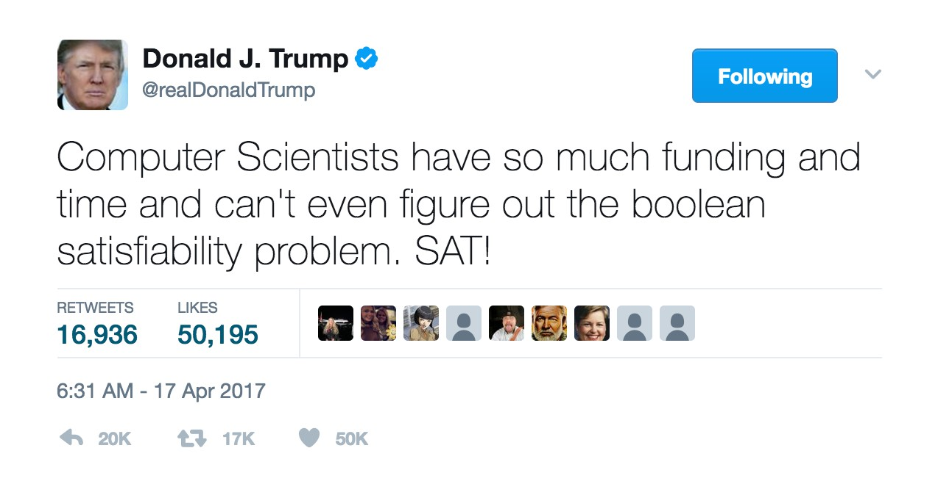
Satisfiability is hard
Scientific hypothesis. There does not exist a poly-time algorithm for 3-SAT.
P vs. NP. This hypothesis is equivalent to P ≠ NP conjecture.
https://www.facebook.com/pg/npcompleteteens

Slide 23
Review
Basic reduction strategies.
・Simple equivalence: INDEPENDENT-SET ≡ _{P} VERTEX-COVER.
・Special case to general case: VERTEX-COVER ≤ _{P} SET-COVER.
・Encoding with gadgets: 3-SAT ≤ _{P} INDEPENDENT-SET.
Transitivity. If X ≤ _{P} Y and Y ≤ _{P} Z, then X ≤ _{P} Z. Pf idea. Compose the two algorithms.
Ex. 3-SAT ≤ _{P} INDEPENDENT-SET ≤ _{P} VERTEX-COVER ≤ _{P} SET-COVER.

Slide 24

Decision, search, and optimization problems
Decision problem. Does there exist a vertex cover of size ≤ k ? Search problem. Find a vertex cover of size ≤ k.
Optimization problem. Find a vertex cover of minimum size.
Goal. Show that all three problems poly-time reduce to one another.
31

Slide 25
Search problems vs. decision problems
VERTEX-COVER. Does there exist a vertex cover of size ≤ k ? FIND-VERTEX-COVER. Find a vertex cover of size ≤ k.
Theorem. VERTEX-COVER ≡ _{P} FIND-VERTEX-COVER.
Pf. ≤ _{P} Decision problem is a special case of search problem. ▪
Pf. ≥ _{P}
To find a vertex cover of size ≤ k :
・Determine if there exists a vertex cover of size ≤ k.
・Find a vertex v such that G − { v } has a vertex cover of size ≤ k − 1. (any vertex in any vertex cover of size ≤ k will have this property)
・Include v in the vertex cover.
・Recursively find a vertex cover of size ≤ k − 1 in G − { v }. ▪
delete v and all incident edges
32

Slide 26
Optimization problems vs. search problems
FIND-VERTEX-COVER. Find a vertex cover of size ≤ k.
FIND-MIN-VERTEX-COVER. Find a vertex cover of minimum size.
Theorem. FIND-VERTEX-COVER ≡ _{P} FIND-MIN-VERTEX-COVER.
Pf. ≤ _{P} Search problem is a special case of optimization problem. ▪
Pf. ≥ _{P} To find vertex cover of minimum size:
・Binary search (or linear search) for size k* of min vertex cover.
・Solve search problem for given k*. ▪
33

Slide 27
Poly-time reductions
constraint satisfaction
3-SAT
ET
poly-time reduces
-S
AT
NDEPENDENT
3-S
to I
Independent-Set
Dir-Ham-Cycle
3-Color
Subset-Sum
Vertex-Cover
Ham-Cycle
Knapsack
Set-Cover
packing and covering
sequencing
partitioning
numerical

Slide 28
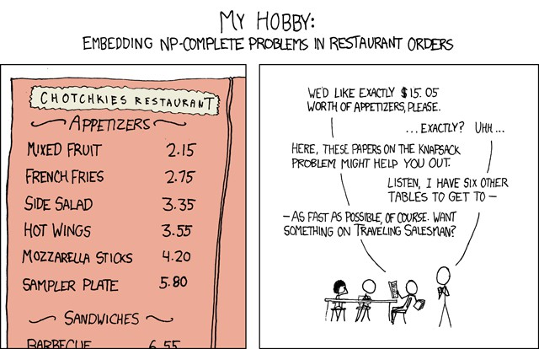
My hobby
NP-Complete by Randall Munro http://xkcd.com/287
Creative Commons Attribution-NonCommercial 2.5

